Slide 1

Redevelopment Designs for Mississippi River Basin
Dr. Johanshir Golchin
President of Energy and Environment Research Group

Slide 2

“I was more powerful glad to get away from the feuds, and so was Jim to get away from the swamp… You feel mighty free and easy and comfortable on a raft”
- Huck Finn

Slide 3
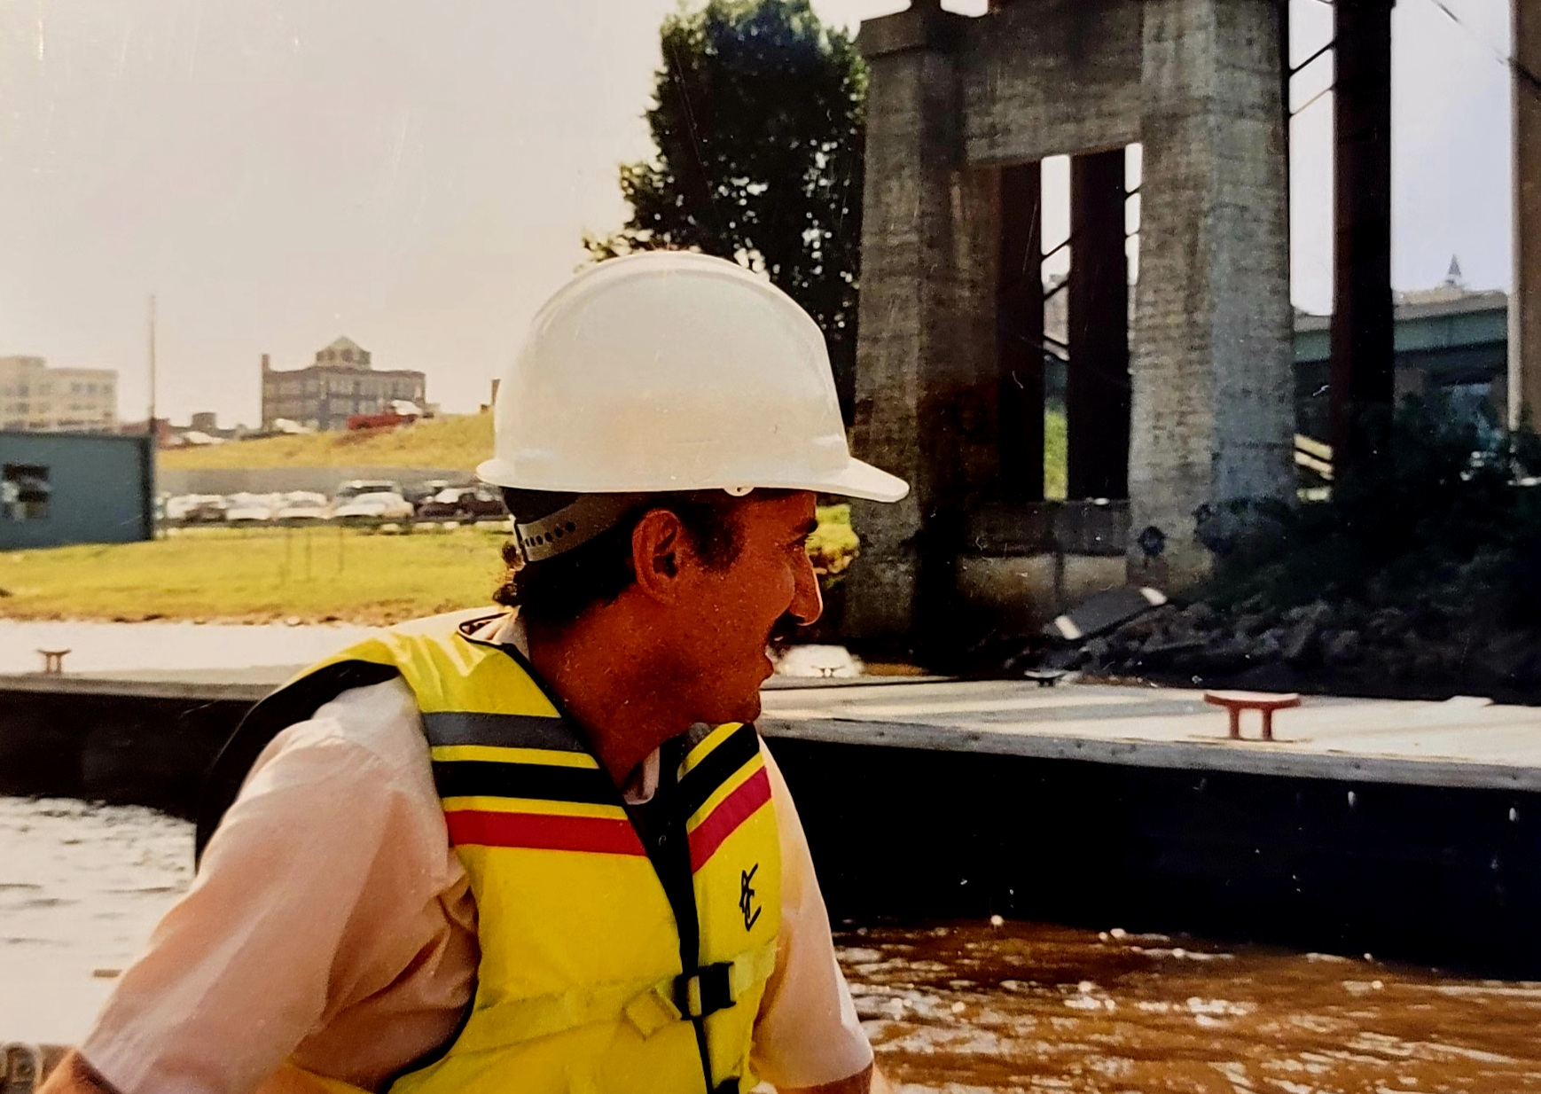
Me Pretending to be a River Rat on the Mississippi River in 1990

Slide 4
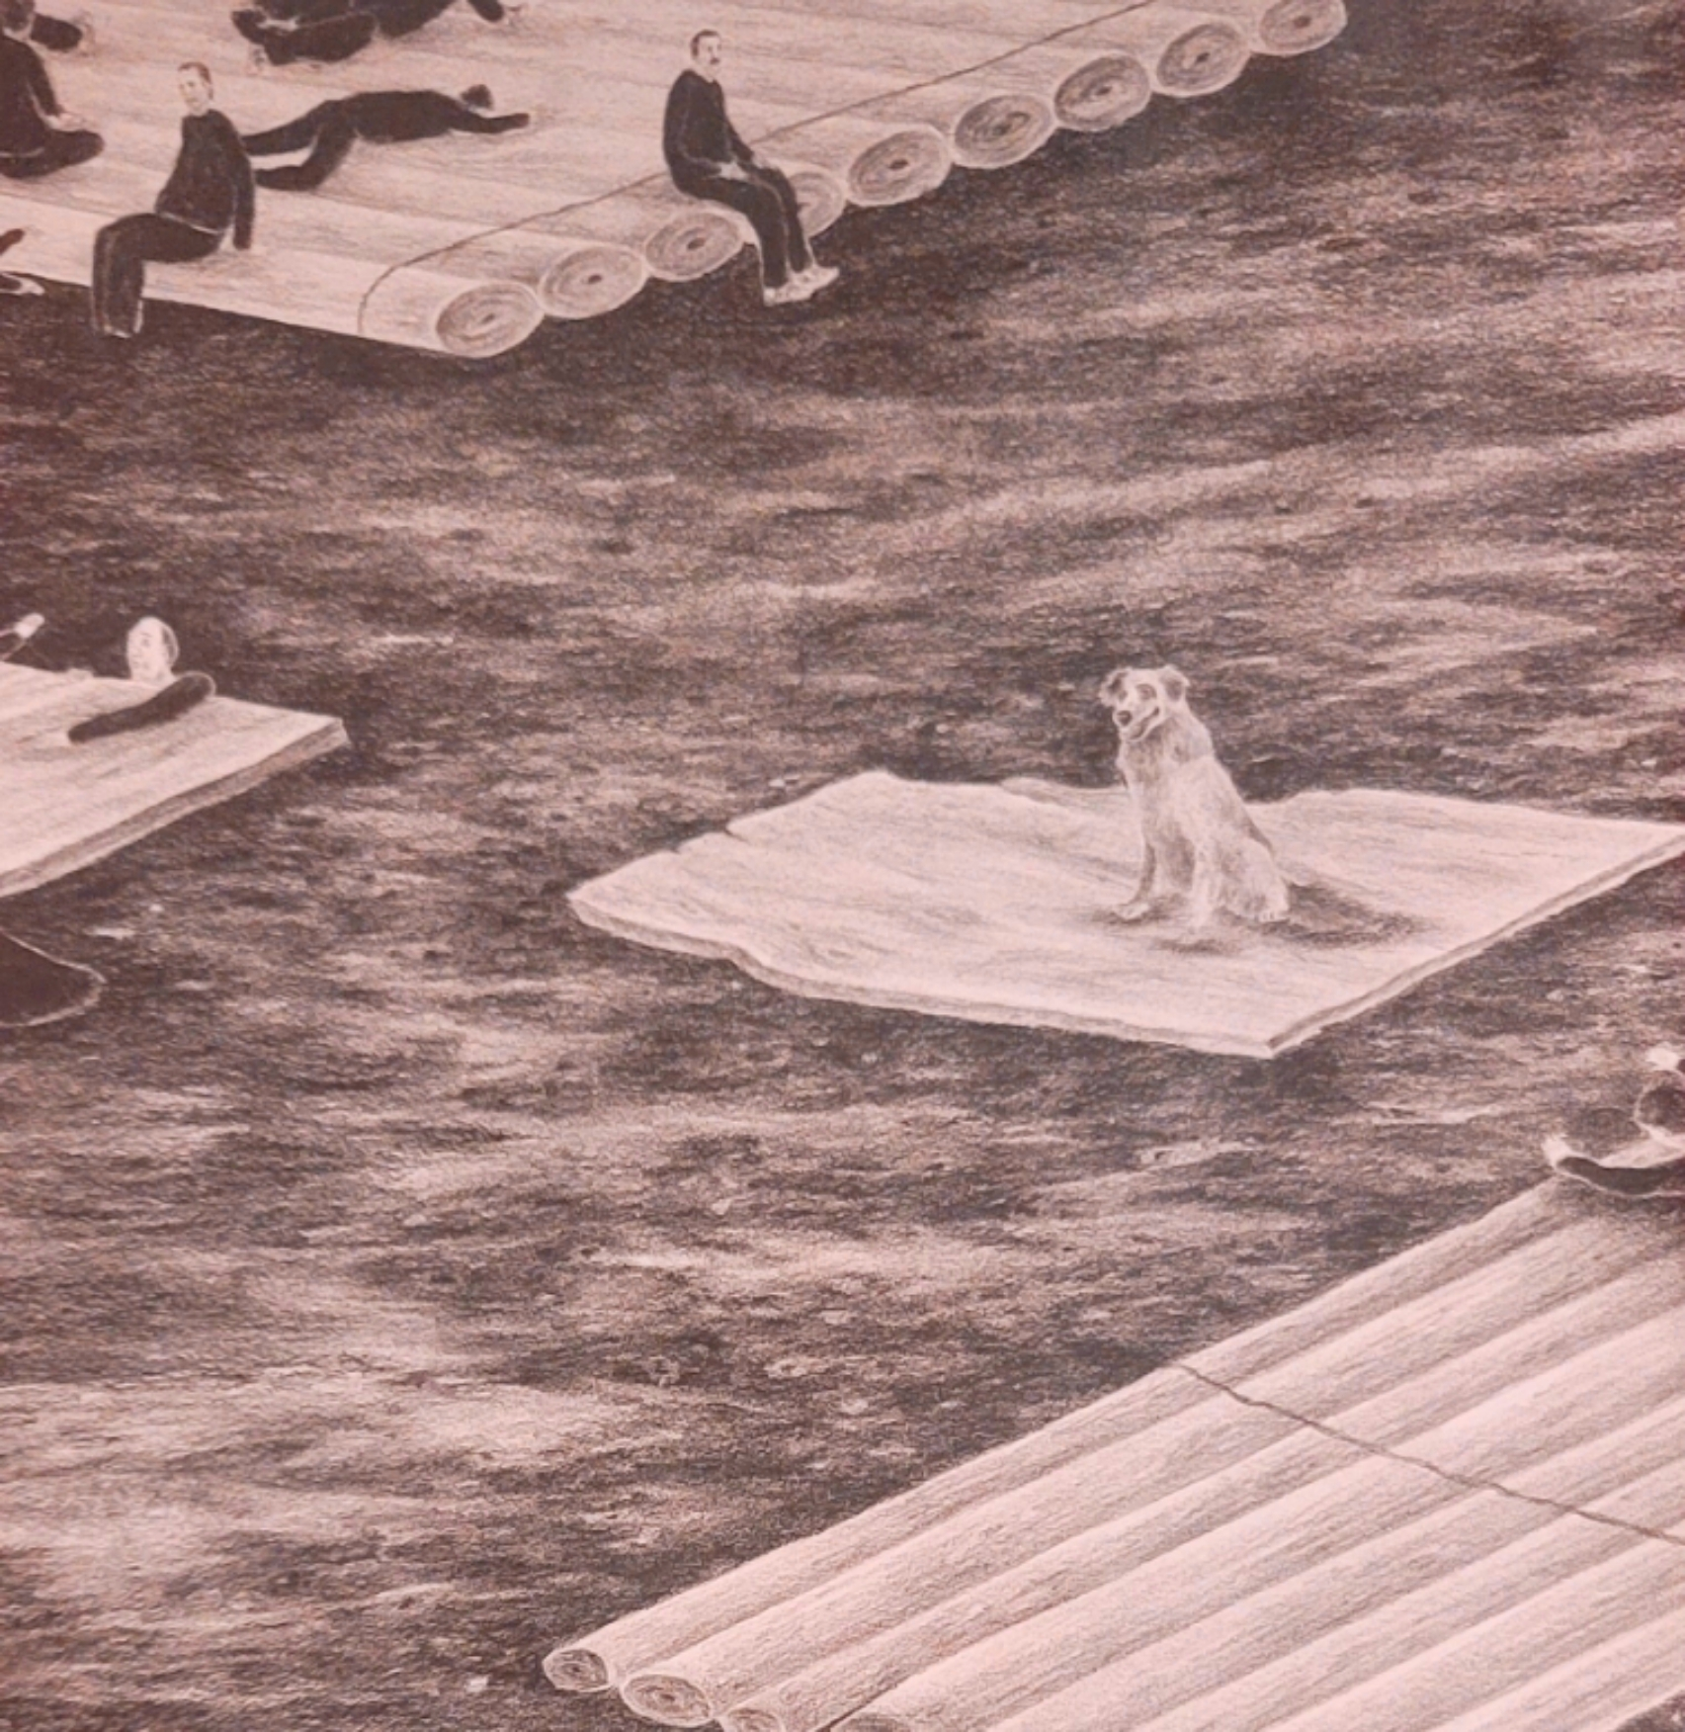
Urgent need for novel plans that are drastically different from chaotic and reactionary actions
"Insanity is doing the same thing over and over again and expecting different results."
  -Rita Mae Brown (NOT Einstein)

Slide 5
The spirt of the River has changed drastically since the days of Huck and Jim
Modernization and routine occurrence of devastating floods have eliminated the “free and easy” feeling they felt on the raft
Flooding of the Mississippi River has been in conflict with levees like a turbulent marriage where couples stay together no matter how bad life is for both
Unfortunately, the real history behind the origin of levees has nothing to do with protecting the landscape around the river, but rather something evil which is further discussed in the main body of this research

Slide 6

What are we talking about?
Problems:
A - Flooding is still an ongoing problem
B - Lack of Critical Thinking
C - Lack of Regional Coordination
D - Not enough Respect for the Ohio River
E – Sources of Problems within the watershed never truly identified

Slide 7

Scope
Governmental reports have shown temporal costs ranging form tens to hundreds of billions of dollars
This presentation explores these costs together with compounded damages
It identifies opportunities to limit both tangible and intangible losses

Slide 8

Why is Critical Thinking Important?
Thinking outside the box
  Boxes in this situation are Levees and Dams
Focus and avoid OVERWHELMING ourselves with too much information – data inputs and opinions
Avoiding crowd sourcing and sticking with expert based designs
Avoiding complexity – Nothing wrong with old fashioned approach

Slide 9
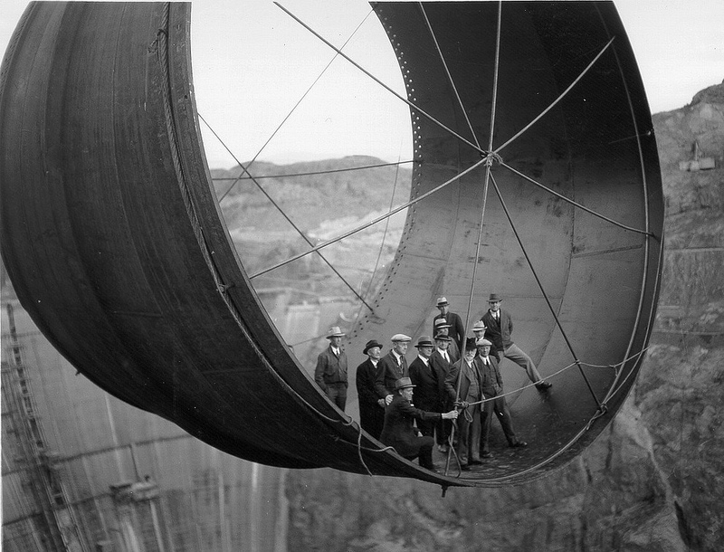
Examples of ”Keeping it Simple” (In a way…)
Hoover Dam
Built over 100 years ago
3 Principal Players
  Concept in 1908 by Arthur Powel Davis
  Architecture by Gordon Kaufmann
  Engineering by Henry Kaiser
It took 20 years for over 400 congressmen to approve the project!

Slide 10
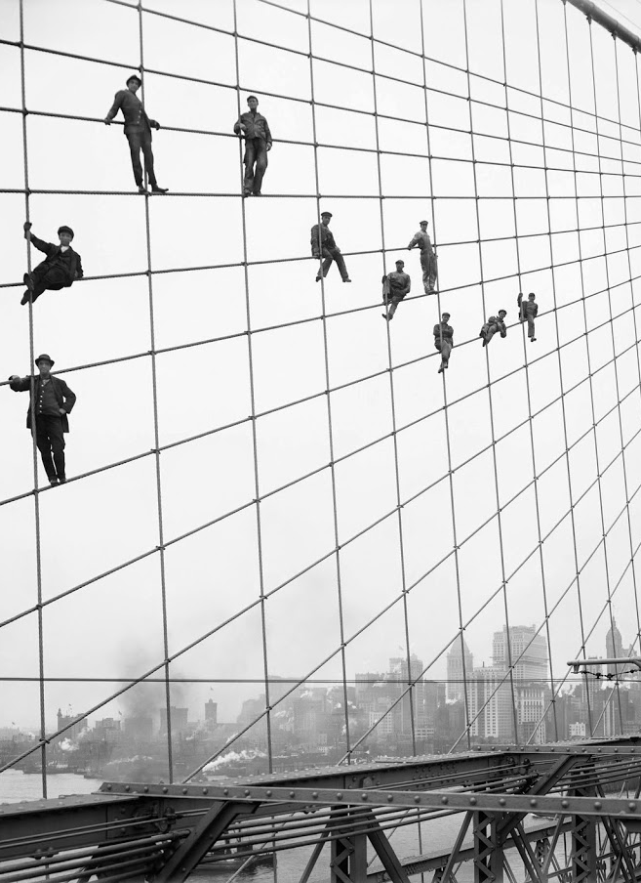
Brooklyn Bridge
Concept and Designed by John Roebling in 1868
Built by his wife and son (And these guys →)

Slide 11
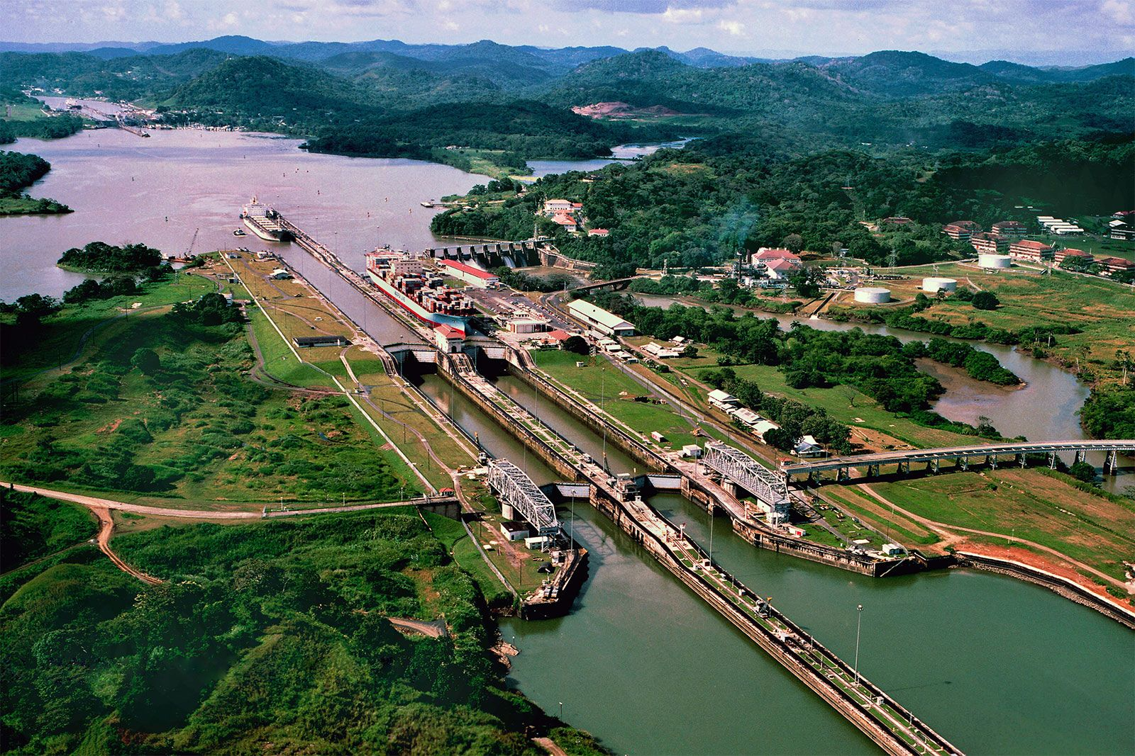
Panama Canal
Prorposed by Frenchman Ferdinand De Lesseps in 1881
Redesigned by American John Frank Stevens

Slide 12
In addition to avoiding COMPLEXITY, we should be avoiding excessive reliance on Computer Modeling
Exceptions could include Statistical, Conceptual, and System Models
  Perhaps minimal use of scale models and using Hydrologic Modeling Systems (HMS) for verification only
  Read about them in USGS sites

Slide 13
Now What? Solutions!
A – Going back to drawing board
B – Believe in our own COMMON SENSE and SIMPLE ideas
Simple ideas like the Hoover Dam produce BIG RESULTS
C – Avoid causing Negative Externalities – costs imposed upon unwitting third parties
Example - building vast parking lot deserts that can cause massive surface runoff that effects downstream sites

Slide 14
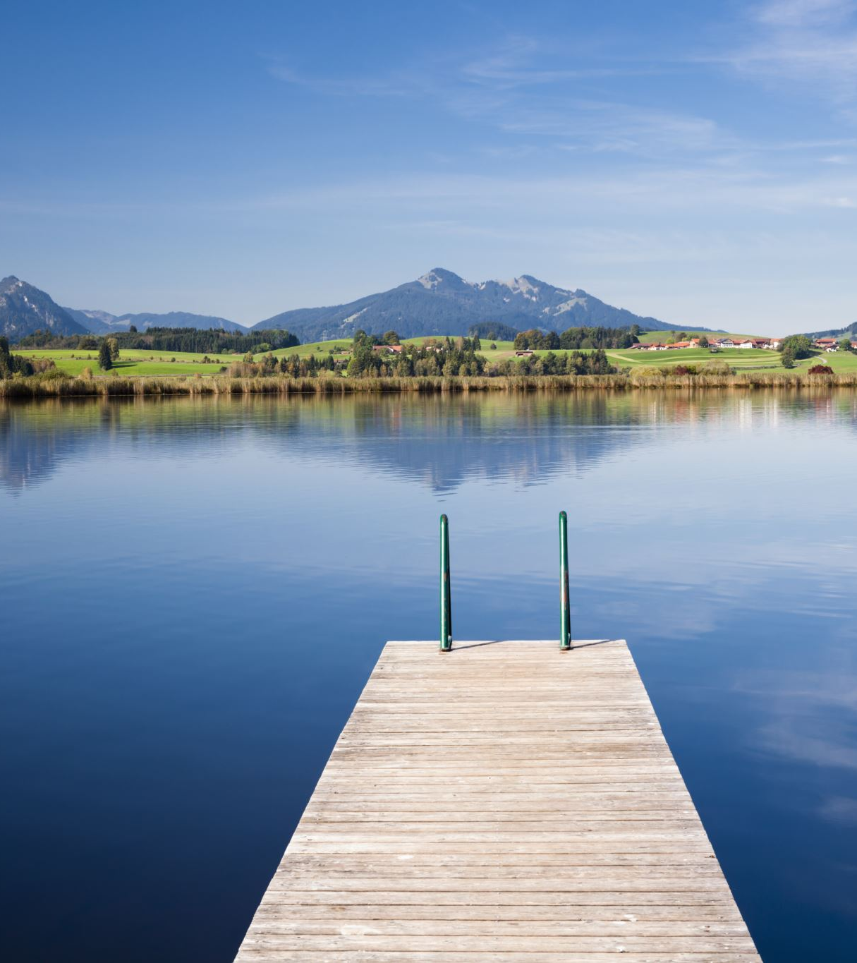
What is the Simple Solution
Diverting Floods towards Retention Ponds (Future Lakes)

Slide 15
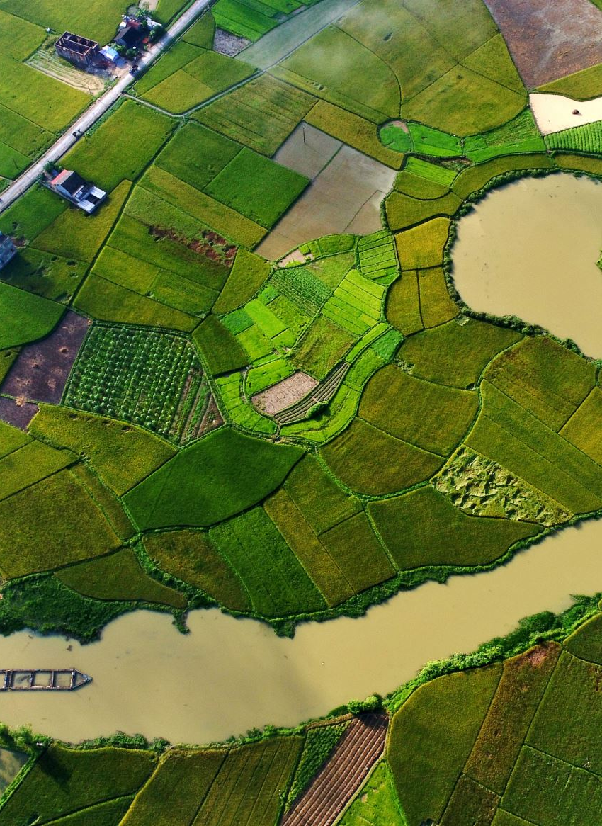
Where and How?
Construct Inflow Spillway Gates into the Diversion Canals
  Most preferably before the lock and dams and right after the confluence of tributaries with the river
Excavate the Ponds
  Capacity calculated based in MAXIMUM FLOW RATE and DURATION of the flood
  MAXIMUM FLOW RATE of 500-year flood for a local watershed is the preferable factor of safety
  Their Locations are determined based on Regional Topology and the landscape plus available lands
Construct Outflow Spillway Gates back into the River
Repeat 1 and 2 alongside required streams with the Mississippi River Basin!

Slide 16
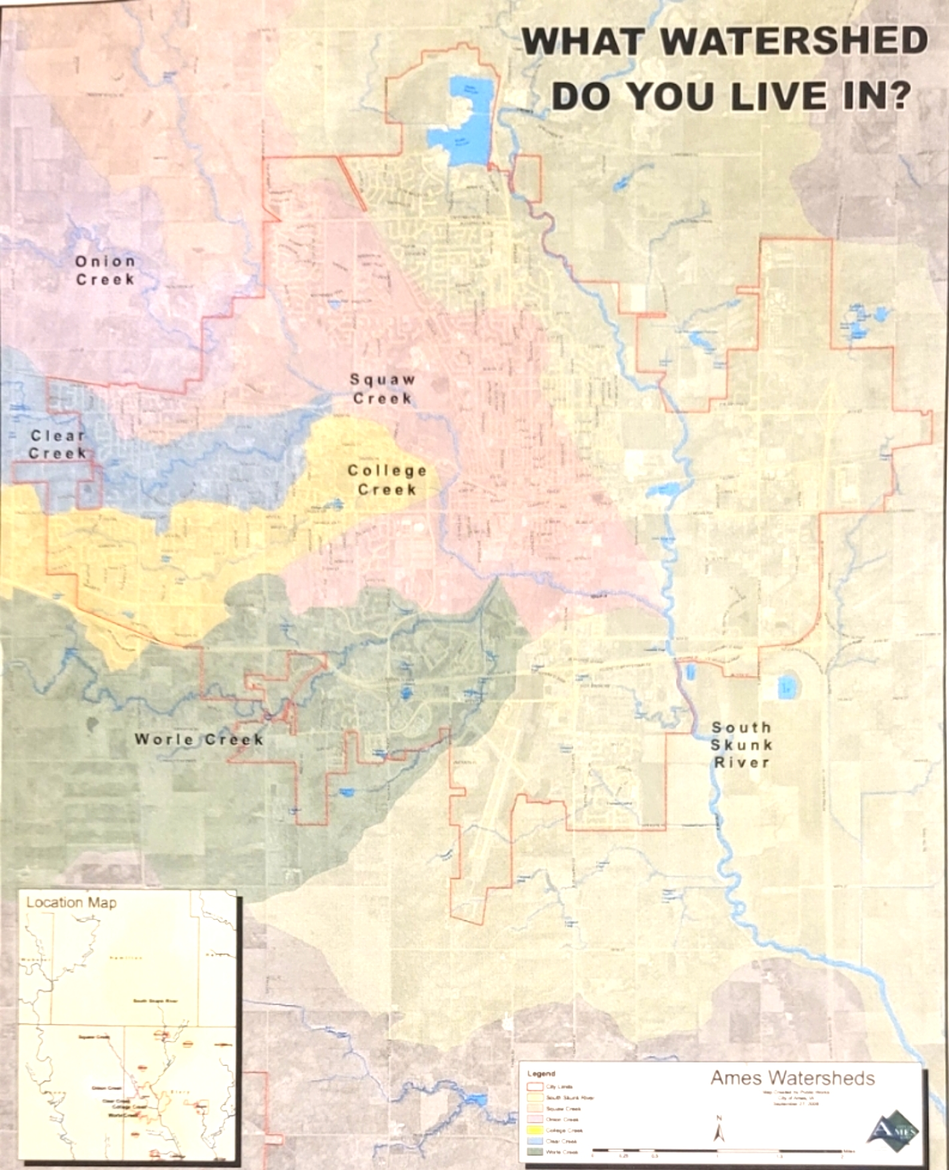
But First…

Slide 17
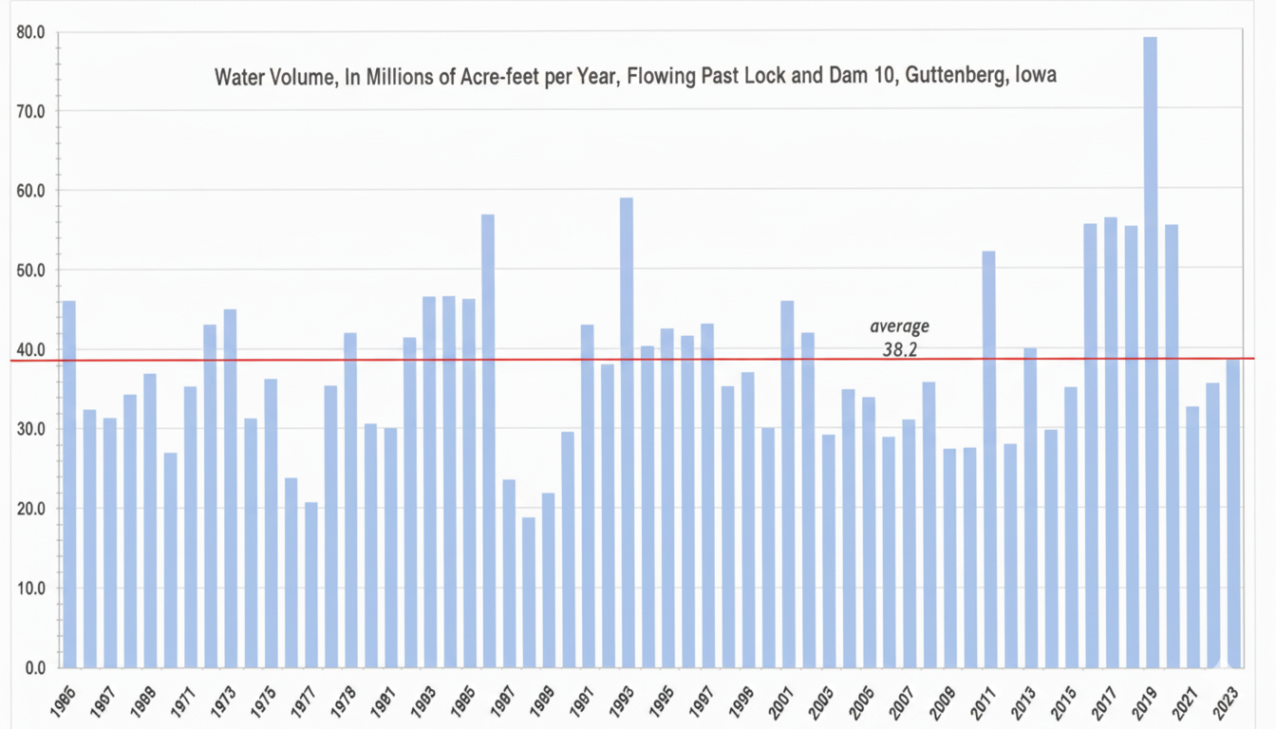

Slide 18
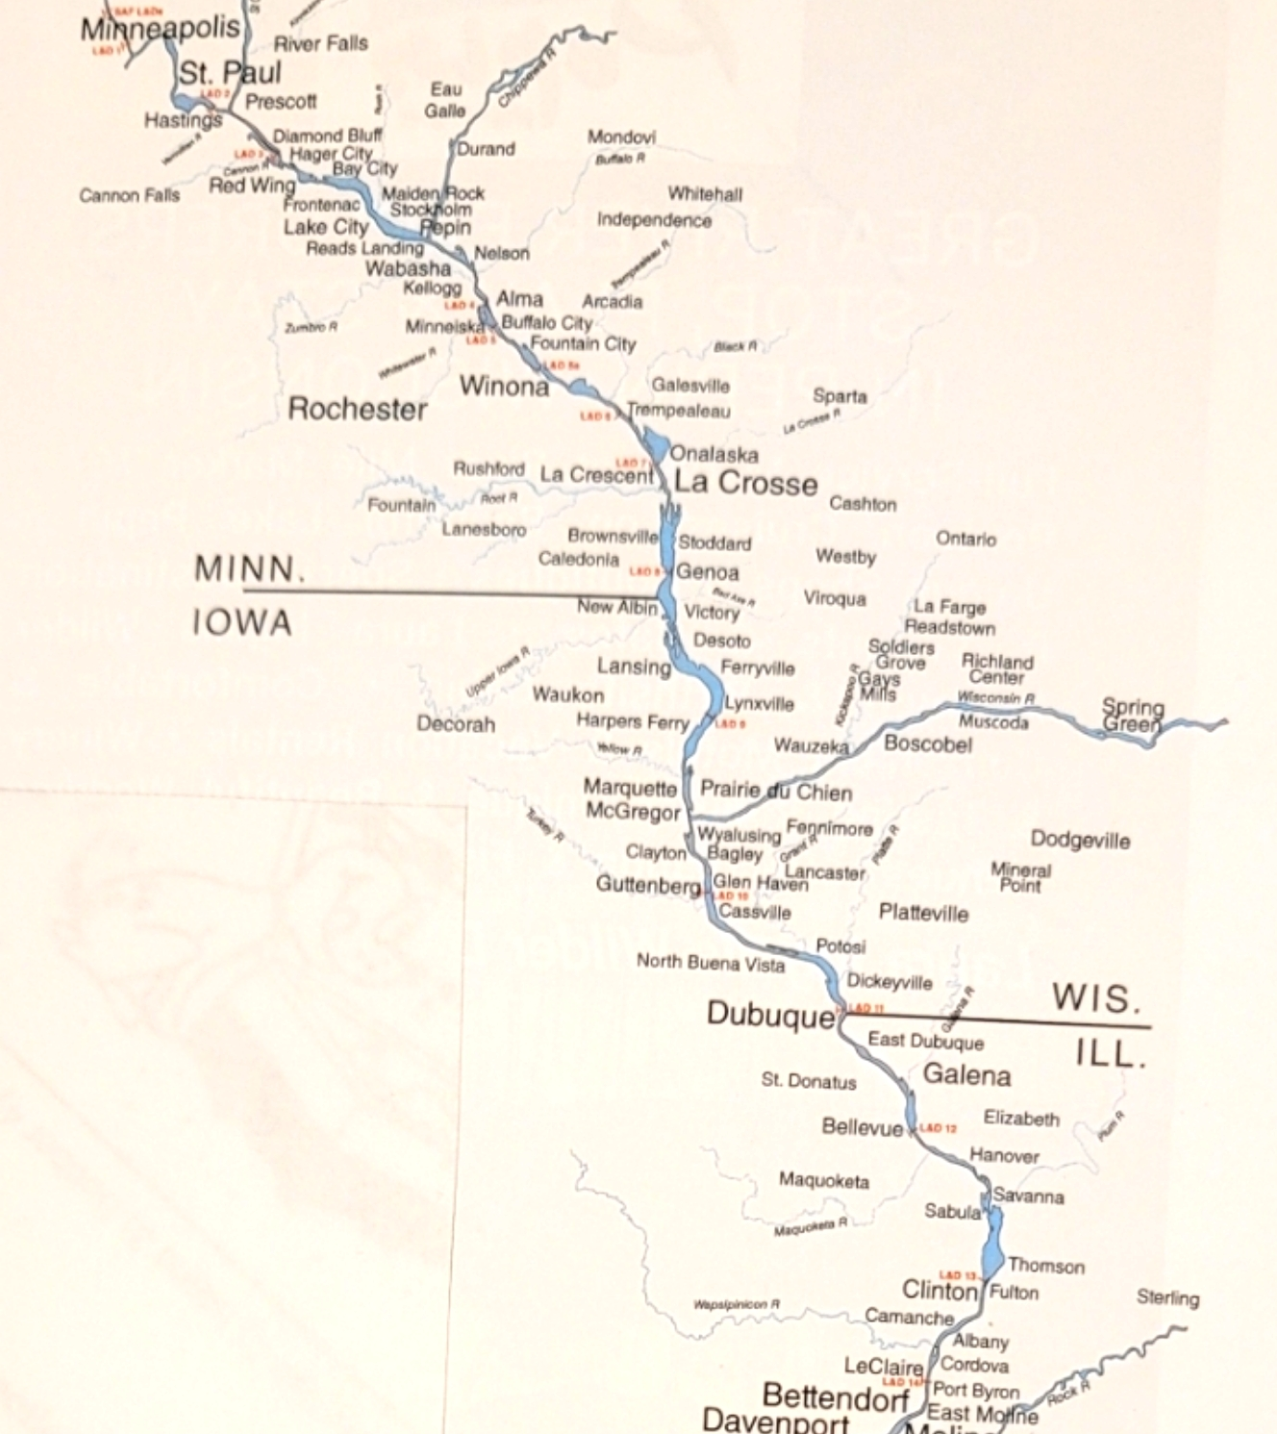
Retention Basin Locations

Slide 19
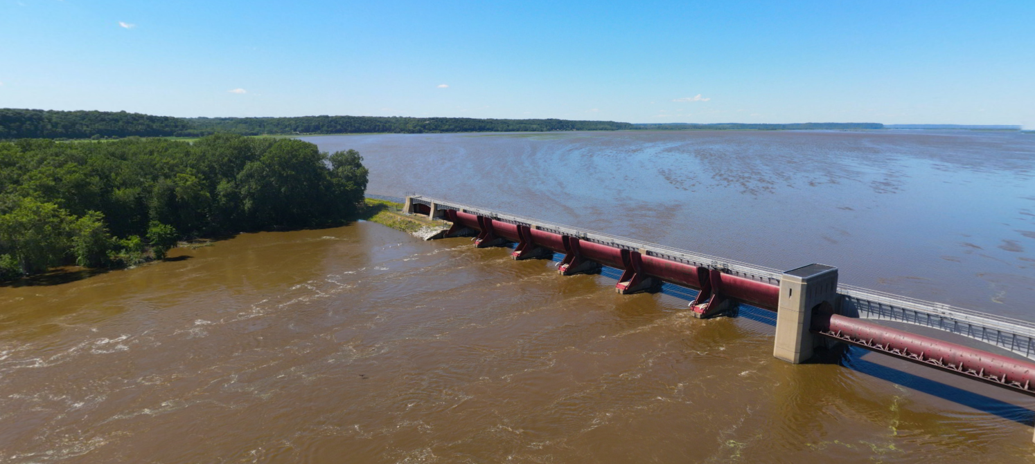
Somewhere Here?
Or Here?
Lock and Dam #13 Clinton (Iowa Side)

Slide 20
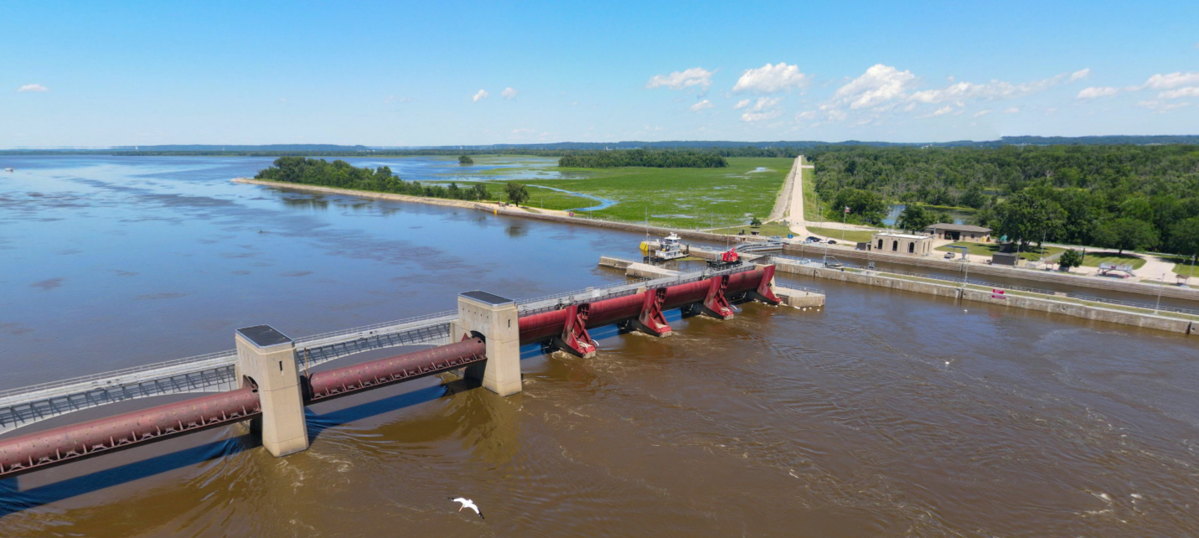
Nowhere here???
Lock and Dam #13 Fulton (Illinois Side)

Slide 21
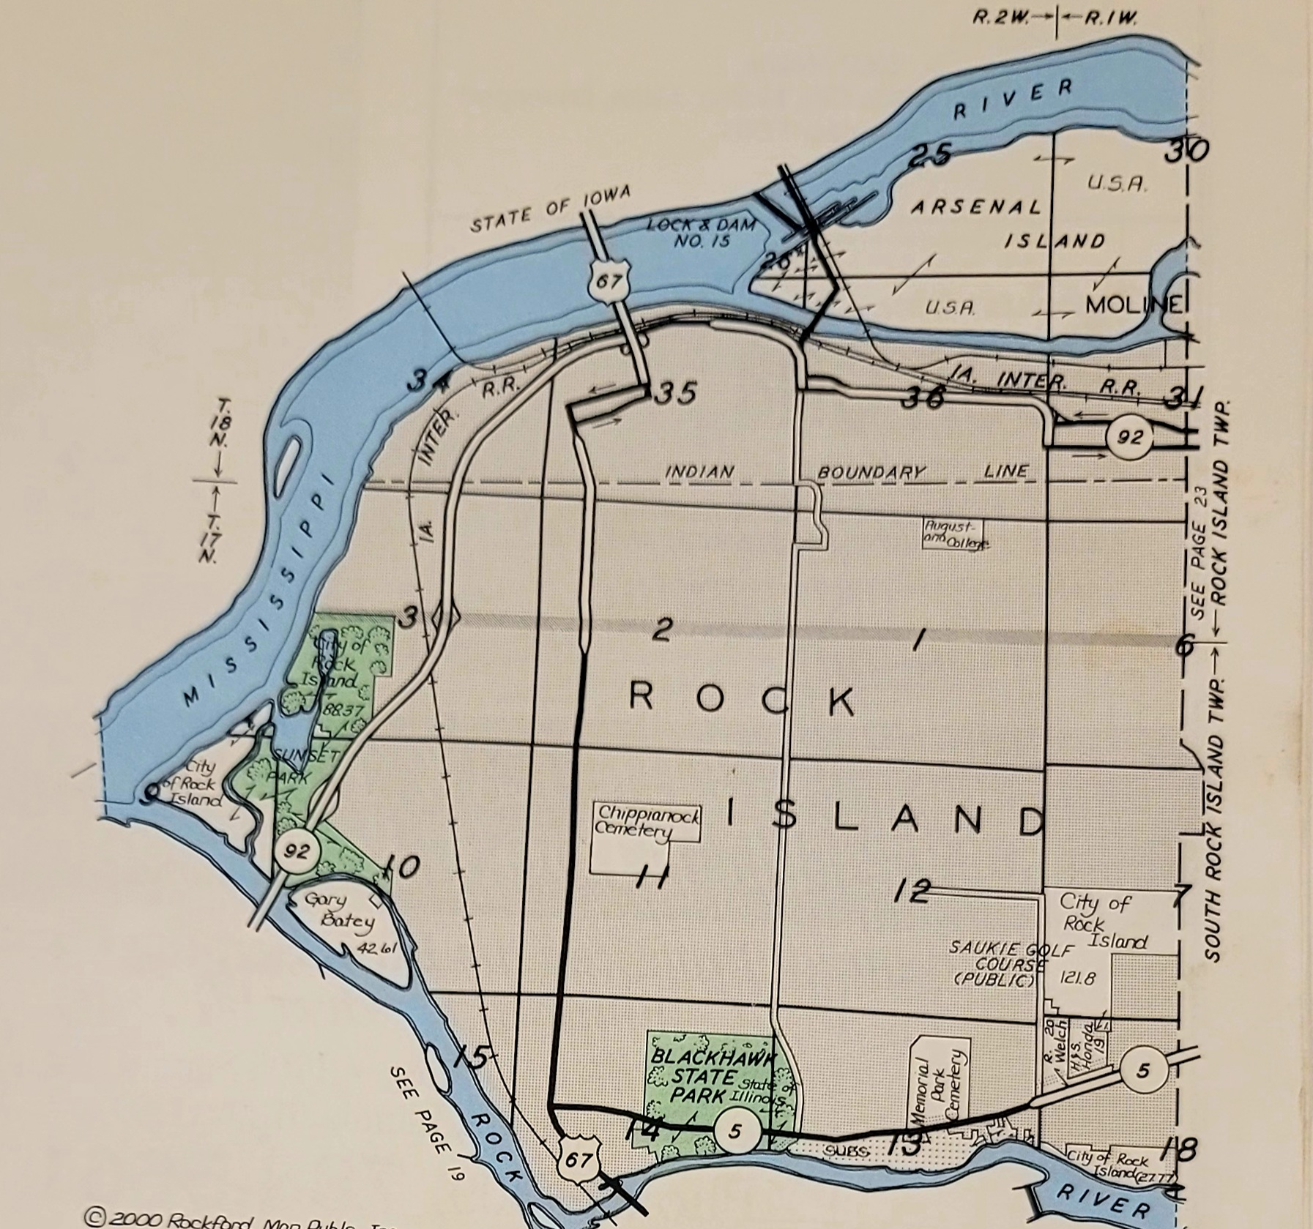
Maybe Here?

Slide 22
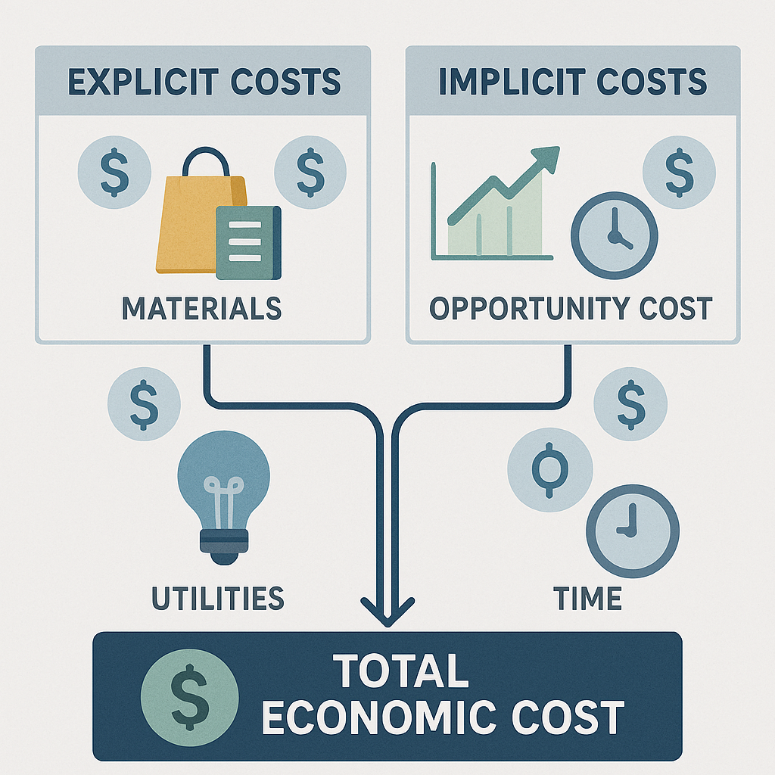
Economics. Always Economics!
Financial costs is the quantifiable measure of devastation
Depending on the source of economic information, temporal costs have ranged from tens to hundreds of billions of dollars
Not many economic reports have reported the real and compound measures of damages
Only a few reports have indicated the REAL COST of flooding
  Excess of THREE TRILLION DOLLARS

Slide 23
Economics. Still Economics
Any development plan, no matter the cost and implementation timeline should be considered an investment for community betterment where once these infrastructure investments are made.
The economic costs presented in the JEC’s report excludes the cost of “Negative Externalities” – the social and emotional stress and lost opportunities for communities impacted by floods.
Considering the astronomical costs to community members lives and welfare, the priority is planning for urgent implementation – specifically proactive action versus historically chaotic reaction.
Economic Costs as reported by the US Congress Joint Economic Committee (JEC) is up to half a trillion dollars a year based on 2023 data.

Slide 24
In Conclusion
Ultimately, we should be moving towards developing a system that moves away from the same-old levee system
We should propose alternatives that not only prevent flooding, but also:
  Enhance the qualities of urban communities
  Improve natural resources of the areas within the Mississippi River watersheds
These alternatives should rely mostly on the utilization of watersheds’ natural system with minimal alteration of the surrounding landscapes

Slide 25
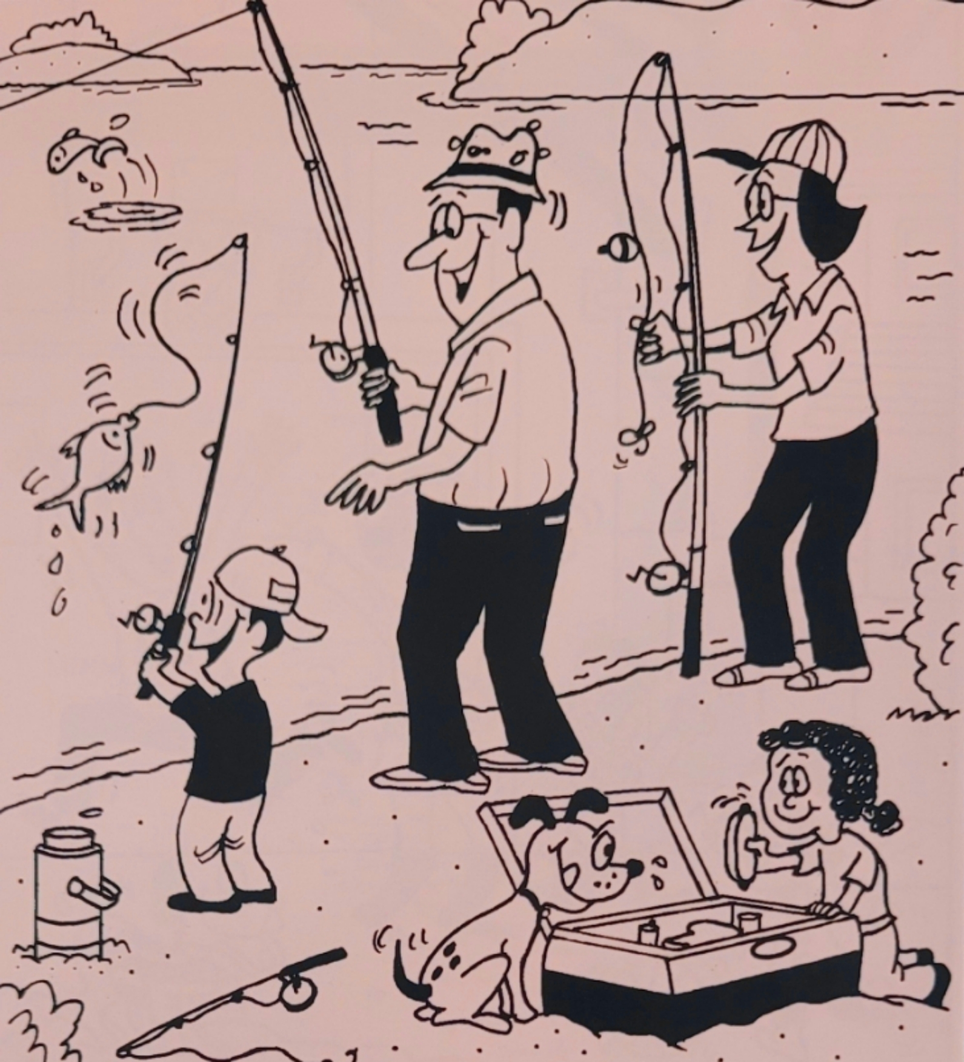

Slide 26

Huck Finn and Jim would Approve

Slide 27




Thank you

